Slide 1
Predicting cybersecurity awareness of users: A case study with Pegasus spyware tweets
S.NO. – 1.14 Authors - Rajvardhan Patil, Subodh Deolekar, Rohit Pandharkar and Uday Salunkhe

Slide 2

Outline
Topics which will be included in this presentation are mentioned below:
Pegasus spyware
How Pegasus works
Literature Review
Source
Methodology
Results.
Conclusion
References

Slide 3
Pegasus Spyware
Pegasus is a type of spyware that attacks your computer, gathers the data from your system and send it to some other remote system located to anywhere in the world.
It was developed by NSO Group.
Pegasus is a type of spyware that attacks your computer, gathers the data from your system and send it to some other remote system located to anywhere in the world.

Slide 4
How it works
Pegasus, spyware, can achieve zero-click installations in various ways makes it so effective and dangerous at the same time.
It uses one over-the-air (OTA) option to send a push message.
The version which was launched in the year 2016 used a technique called as “Spear Phishing”.
The version which was launched in the year 2019 used whatsapp calls to enter the targeted device.

Slide 5
LITERATURE REVIEW
Spyware is one of the most dangerous security threats to both individual users and corporate networks. Alexander Moshchuk.
These spywares can run in the background on victims' computers or travel via the Internet or local networks. Other varieties of spyware are managed and directed remotely by their developers. Martin Boldt.
Spyware may effectively attack Internet users' privacy by collecting data, managing systems, and/or reporting the activities of victims' computers and networks. Greg Banks
If a network is severely overloaded by various forms of spyware delivered by computerized systems controlled by malevolent individuals, a dangerous situation may result. Richard A. Kemmerer.

Slide 6
Source
Twitter is an independent platform where people can share their opinions without any restriction which makes it one of the best sources for gathering data for this type of project.
Sentiment analysis on this data will allow us to keep track of what's being said about any topic on social media and can help us understand public sentiments for this topic.

Slide 7
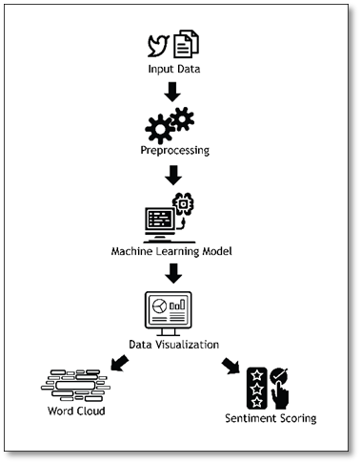
Methodology

Slide 8
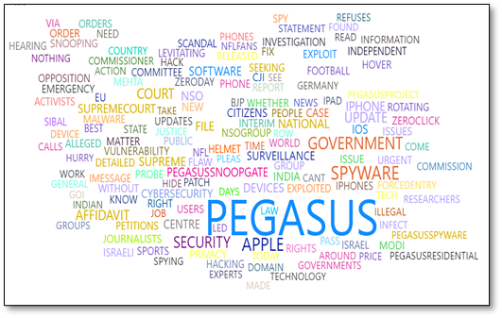
Results

Slide 9
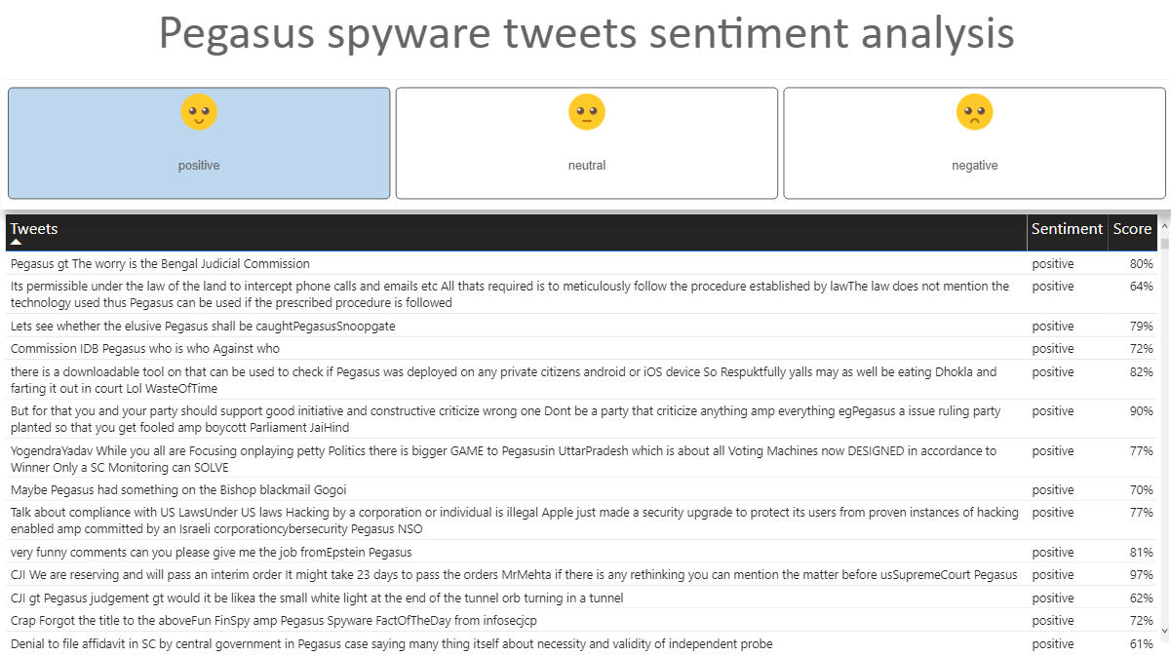
Results

Slide 10
Results
Security, Government, Spyware, Pegasus, Apple are the most recurring words in the extracted tweets.
Privacy, Social Security, Cyber Threats were not the top mentions in the extracted tweets.
From simple analysis of the tweets related to this matter, it was found that Twitter was extensively used for blaming and accusing the government and the agencies that develop and use this software instead spreading knowledge about the spyware and helping people on how to avoid getting victimized by such spywares.

Slide 11
Conclusion
We observed that there are blend of sentiments available for the Pegasus spyware. In this paper, the cumulative sentiment score was positive which means there is a lack of knowledge among the people about these spywares.
Users' knowledge in these areas is still lacking, and they must take more effective actions in order improve it.
The fundamental reason for this was a lack of proper training. The government should put in efforts to make people more aware about the different types of spywares and the evolving cyber threats.

Slide 12
References
M. Boldt, B. Carlsson and A. Jacobsson. "Exploring Spyware Effects", 2010.
M. Egele, C. Kruegel, E. Kirda, H. Yin and D. Song. “Dynamic spyware analysis”. In 2007 USENIX Annual Technical Conference on Proceedings of the USENIX Annual Technical Conference (ATC'07). USENIX Association, USA, 2007, Article 18, 1–14.
E. Kirda and C. Kruegel. “Behavior-based Spyware Detection”. 2006. [Online] Available: https://www.auto.tuwien.ac.at/~chris/research/doc/usenix06_spyware.pdf.
Greg Banks, Giovanni Vigna, and Richard A. Kemmerer Department of Computer Science University of California, Santa Barbara {nomed,vigna,kemm}@cs.ucsb.edu
A. K. Jose, N. Bhatia, and S. Krishna, “TwitterSentimentAnalysis”. NationalInstituteof TechnologyCalicut,2010

Slide 13
Thank you

